Slide 1

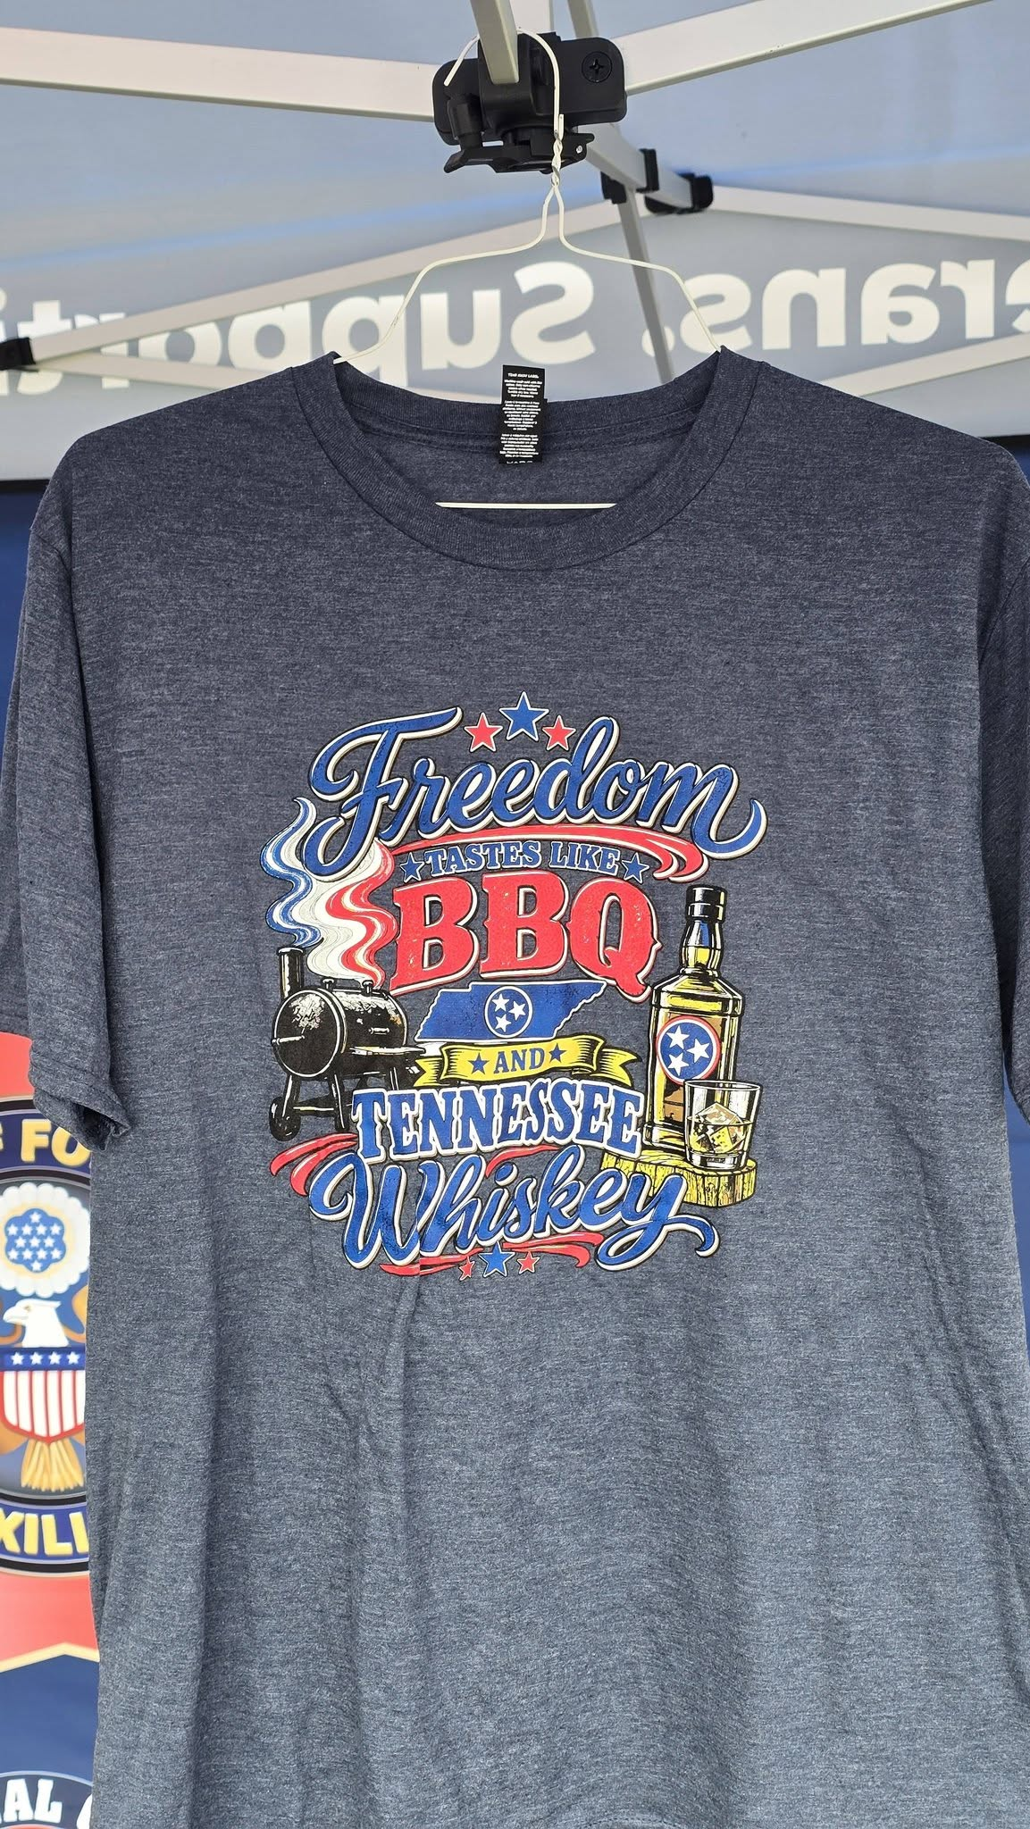
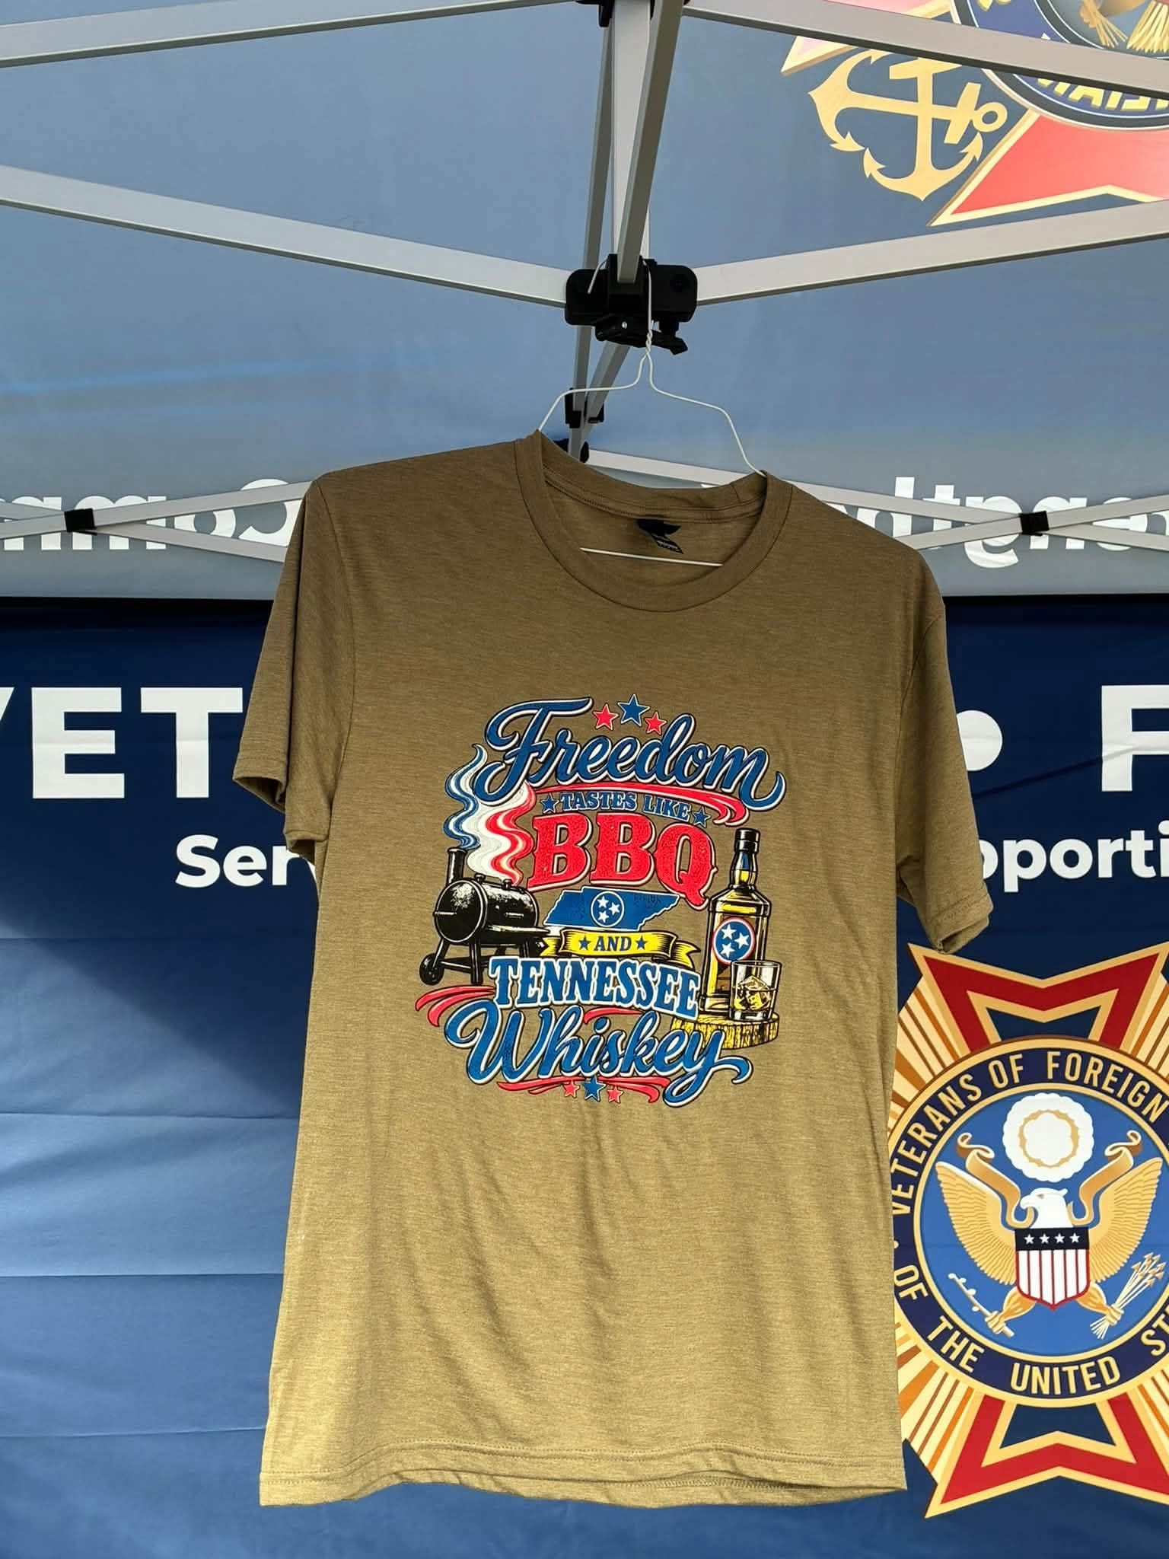

Heathered Navy
Olive Tan
Veterans Day BBQ T Shirts for Sale!!!
$20 each---All sizes available

